Slide 1
Introduction to Machine Learning and Data Mining (Học máy và Khai phá dữ liệu)
Khoat Than Le Minh Hoa, Nguyen Van Son
School of Information and Communication Technology
Hanoi University of Science and Technology

Slide 2
Content
Introduction to Machine Learning & Data Mining
Data crawling and pre-processing
Supervised learning
Unsupervised learning
Practical advice

Slide 3
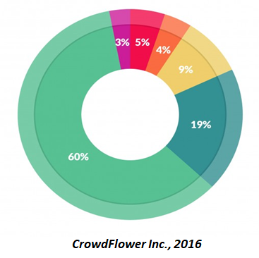
Spend time in data science tasks
What data scientists spend the most time doing?
Collecting data: 19%
Cleaning and organizing data: 60%
Building training datasets: 3%
Data mining: 9%
Refining algorithms: 4%
Others: 5%

Slide 4


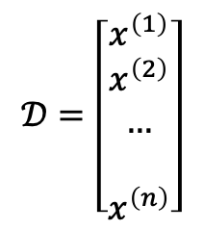
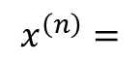
Why?
Why preprocess the data?
Convenient in storage, query data
Machine learning models usually work with structured data: matrices, vectors, arrays, etc.
Machine learning usually works well if there is a suitable representation of the data
Input Problems to be solved
Output
Numeric data - matrix, vector
-0.0920
3.4931
-1.8493
...
...
-0.2010
-1.3079
$$𝒟=\left[\begin{matrix}x^{\left(1\right)} \\ x^{\left(2\right)} \\ … \\ \\ x^{\left(n\right)}\end{matrix}\right]$$
$$x^{\left(n\right)}=$$

Slide 5
How?
Data collection
Sampling
Method: crawling, logging, scraping
Data processing
Noise filtering, cleaning, digitizing…

Slide 6
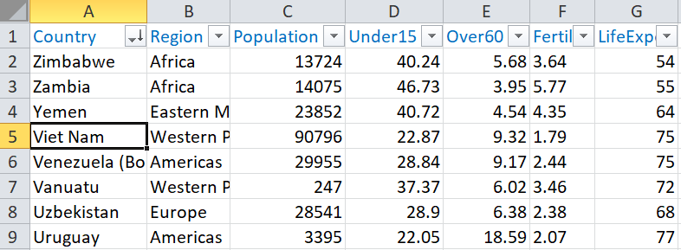
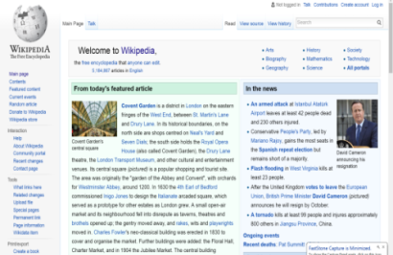

Data collection
Input Problems to be solved
Output
Data samples

Slide 7
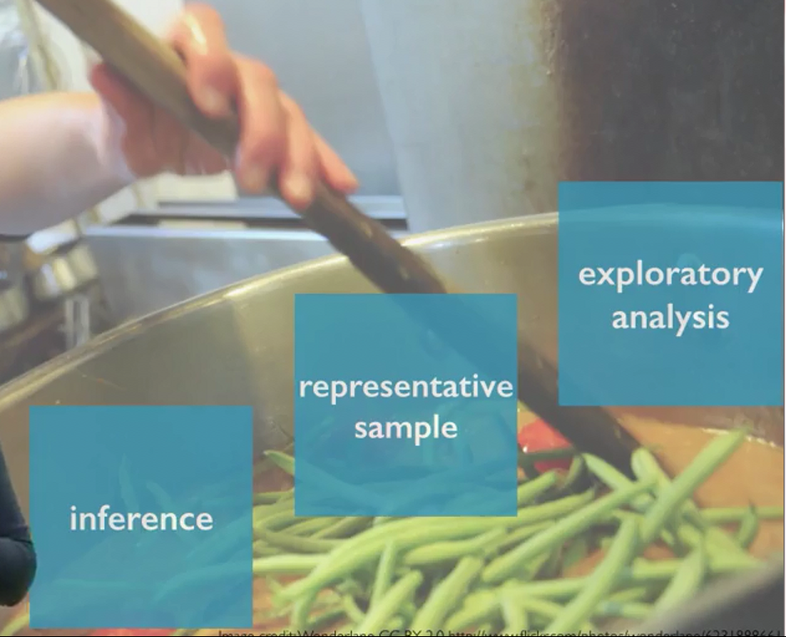
Fundamentals :: Sampling
WHAT – Take a small, generalized set of samples to represent the field to be learned
WHY – can't learn the whole thing due to time and computational power limitations
HOW – Collect samples from real life, or web data sources, databases…
“One or more small spoon(s) can be enough to assess whether the soup is good or not.”
https://www.coursera.org/learn/inferential-statistics-intro

Slide 8
Fundamentals :: Sampling :: How
Variety – the sample set is diverse enough to cover all contexts of the field/domain.
Bias – data needs to be generalised, not biased towards a small part of the field.
“One or more small spoon(s) can be enough to assess whether the soup is good or not.”
Remember to stir to avoid tasting biases.
https://www.coursera.org/learn/inferential-statistics-intro

Slide 9
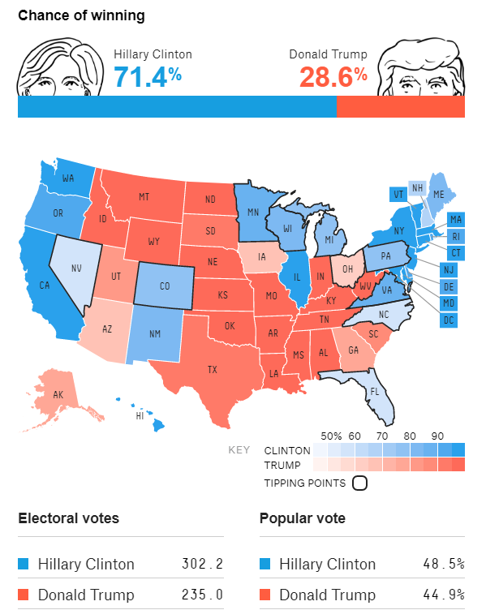
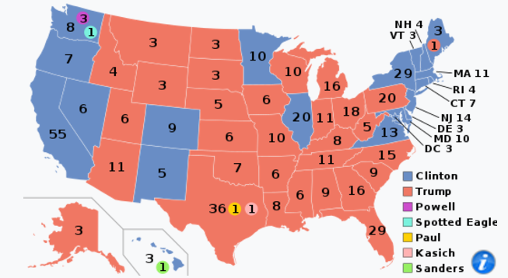
Fundamentals :: Sampling :: How
Variety – samples vary enough to reflect reality?
Actual results
https://projects.fivethirtyeight.com/2016-election-forecast/
http://edition.cnn.com/election/results/president
Image credit: Wikipedia, FiveThirtyEight
https://www.coursera.org/learn/inferential-statistics-intro

Slide 10
Techniques
Crowd-sourcing: Conduct surveys
Logging: record user interaction history, product access...
Scrapping: Search data sources on websites, download, extract, filter data

Slide 11
Techniques :: Scrapping :: DEMO
Objective: Data for the problem of text classification – newspaper articles.
DEMO: Newspaper crawling system

Slide 12
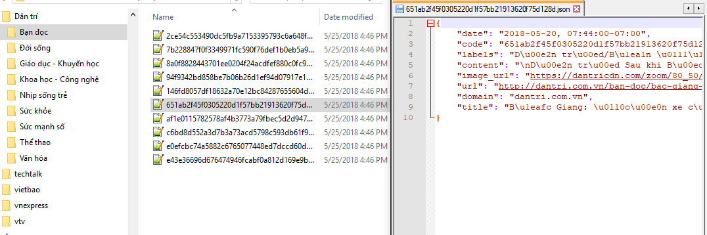
DEMO
Input Problem: classifying newspaper articles
Output
Sample data: newspaper articles and lables

Slide 13
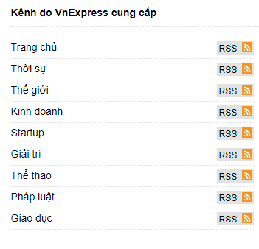
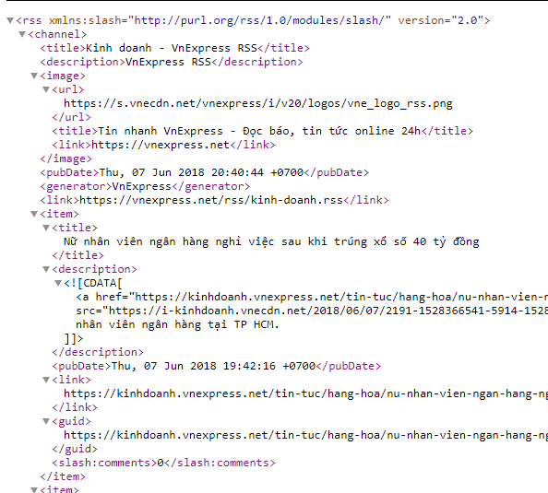
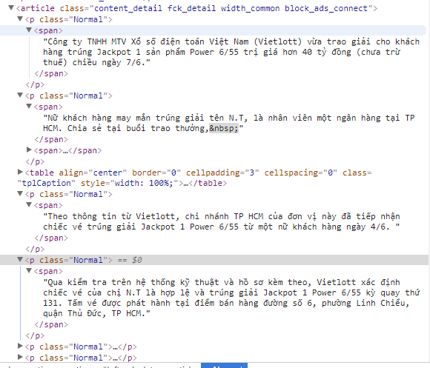
DEMO :: Steps
Rss
Item
Content

Slide 14
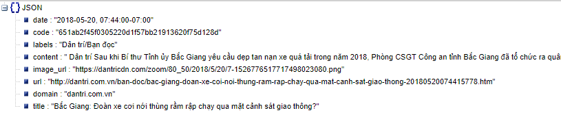
DEMO :: Sample

Slide 15
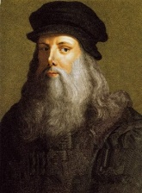
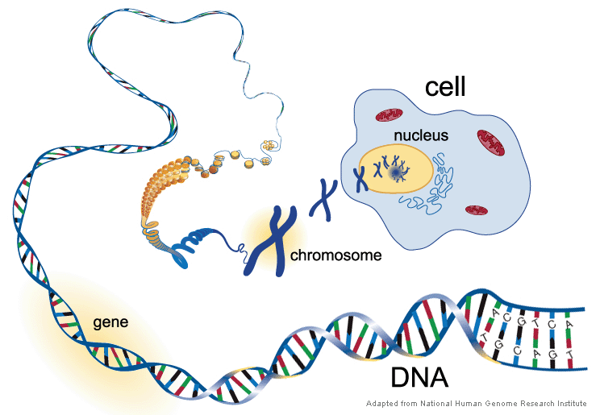
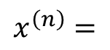
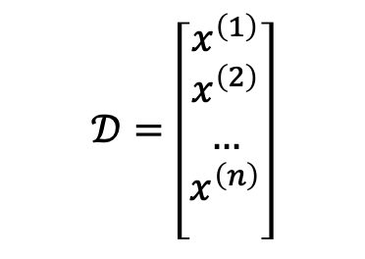
Data preprocessing
Input Raw data samples (text, image, audio...)
Output Digital data for ML/AI model(s)
-0.0920
3.4931
-1.8493
...
...
-0.2010
-1.3079
$$𝒟=\left[\begin{matrix}x^{\left(1\right)} \\ x^{\left(2\right)} \\ … \\ x^{\left(n\right)} \\ \end{matrix}\right]$$
$$x^{\left(n\right)}=$$

Slide 16
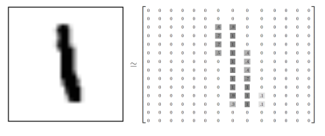

Fundamentals :: Data “rawness”
Completeness (đầy đủ)
Each collected sample should have all the required attribute
Integrity (trung thực)
Official collection source, ensure the sample contains the correct value in reality
Jan. 1 as everyone’s birthday? – intentional (systematic) noises
Homogeneity (đồng nhất)
Rating “1, 2, 3” & “A, B, C”; or Age = “42” & Birthday = “03/07/2010” (inconsistency)
Heterogenous data sources / schemas
Structures (cấu trúc)

Slide 17
Techniques
Cleaning
Integrating
Transforming

Slide 18
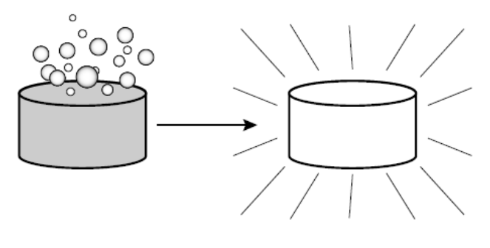
Techniques :: Cleaning
Completeness and integrity
Data samples should be collected from reliable sources. Reflect the problem to be solved.
Eliminate (outliers) noise: remove some data samples that are significantly different from other samples
A data sample may be empty (missing, incomplete), a suitable strategy is needed:
Ignored, not included in the analysis?
Add missing fields to the data sample?

Slide 19
Techniques :: Cleaning
Fill in the missing value
Fill in the missing value manually
Use a global constant
Use and “average” value
Use average value for all samples belonging to the same class/group
Use the most probable value (regression, bayesian inference)
A1 | A2 | A3 | A4 | A5 | A6 | A7 | A8 | y
? | 3.683 | ? | -0.634 | 1 | 0.409 | 7 | 30 | 5
? | 3.096 | A | 1.573 | 1 | 0.639 | 7 | 30 | 5
? | ? | A | 0.249 | 0 | 0.089 | ? | 80 | 3
2.887 | 3.870 | C | -1.347 | ? | 1.276 | ? | 60 | 5
2.731 | 3.945 | D | 1.967 | 1 | 2.487 | ? | 100 | 4

Slide 20
Techniques :: Cleaning (cont.)
Data uniformity
Different data presentation, units of measure, metrics etc.
Examples:
Rating “1, 2, 3” & “A, B, C”;
Age = 42 & Birthday = 03/08/2020

Slide 21
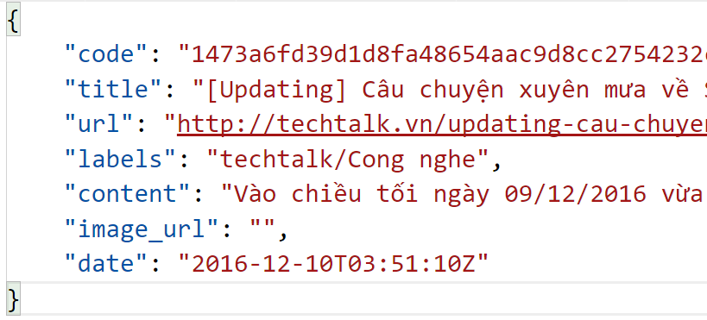
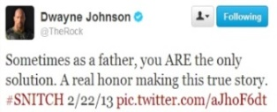
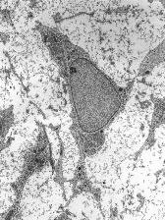
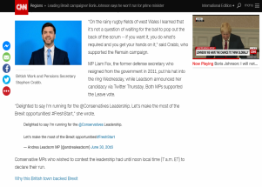
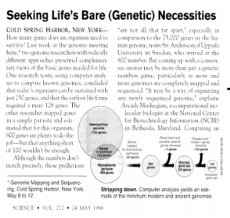

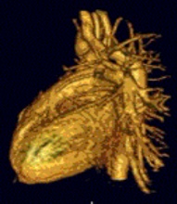

Techniques :: Integrating w/ some Transforming
Un-structured
``
texts in websites, emails, articles, tweets
2D/3D images, videos + meta
spectrograms, DNAs, …
image credits: wikipedia, shutterstock, CNN

Slide 22
Techniques :: Transforming
Semantics?
Extract semantic features, normalize

Slide 23
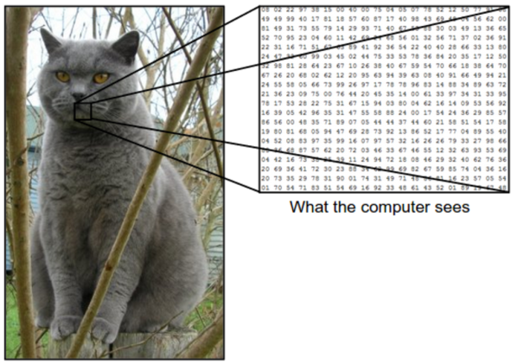
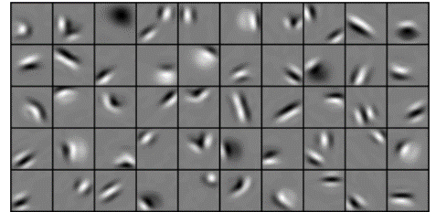
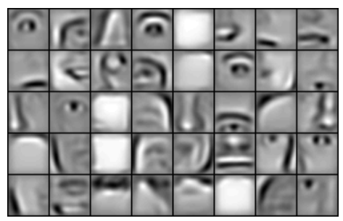
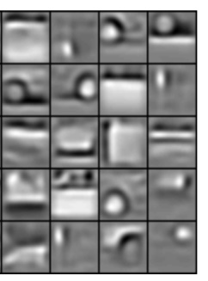
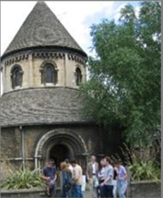
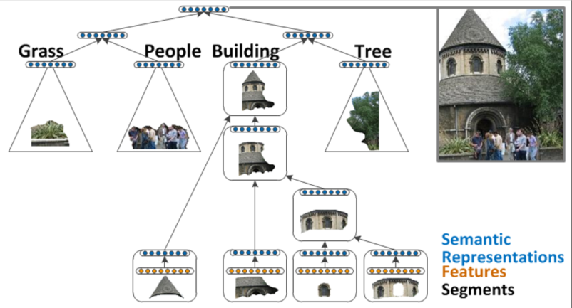
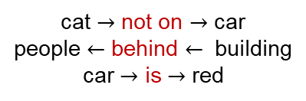
Semantics example: visual data
Low-level semantics (raw pixels)
``
Mid-/High-level semantics (e.g. human-interpretable features)
cat $→$ not on $→$ car
people $←$ behind $←$ building
car $→$ is $→$ red
Minimum semantic level to understand:
Text classification
Emotional analysis
AI Chatbot (various semantic levels)
Image credits: CS231n, Stanford University; Lee et al, 2009; Socher et al, 2011

Slide 24
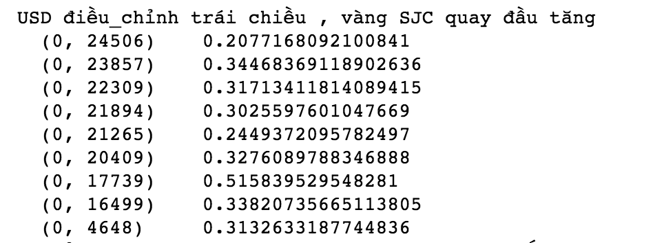
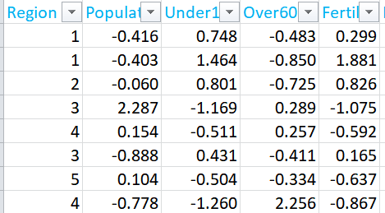
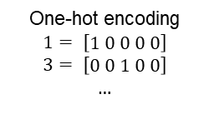
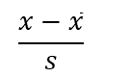
Techniques :: Transforming (cont.)
Objective: to extract semantic features.
For specific field, type of data, using different semantic feature extraction techniques (text data, images, ...)
… and standardize
Feature discretization (rời rạc hoá): Some attributes are more efficient when grouped values.
Feature normalization (chuẩn hóa): normalize attribute values to the same domain, easy to calculate.
One-hot encoding
$$1= \left[\begin{matrix}1 0 0 0 0\end{matrix}\right]$$
$$3= \left[\begin{matrix}0 0 1 0 0\end{matrix}\right]$$
$$…$$
$$\frac{x−\overline{x}}{s}$$

Slide 25
Techniques :: Transforming (cont.)
Data reduction:
Helps reduce the size of the data and, at the same time, preserve the core semantics of the data.
Helps speed up the process of learning or knowledge discovery.
Some strategies:
Feature selection: redundant attributes or dimensions can also be eliminated
Dimensional reduction: use some algorithms (eg. PCA, ICA) to transform the original data into a less dimensional space.
Abstraction: raw data values are replaced by abstract concepts.

Slide 26
Techniques :: Transforming example & demo
Transforming text data

Slide 27
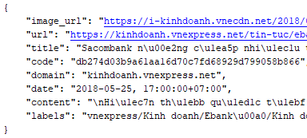
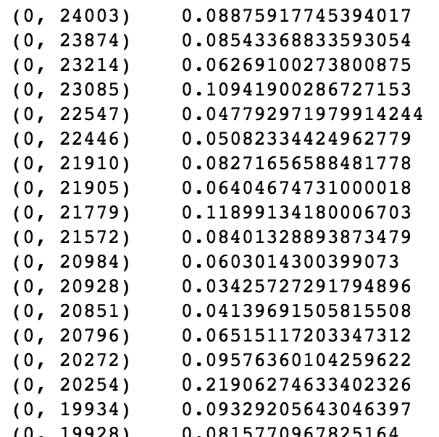
DEMO
Input Mẫu dữ liệu thô: json text
Output Dữ liệu số theo từng ML/AI model(s)

Slide 28
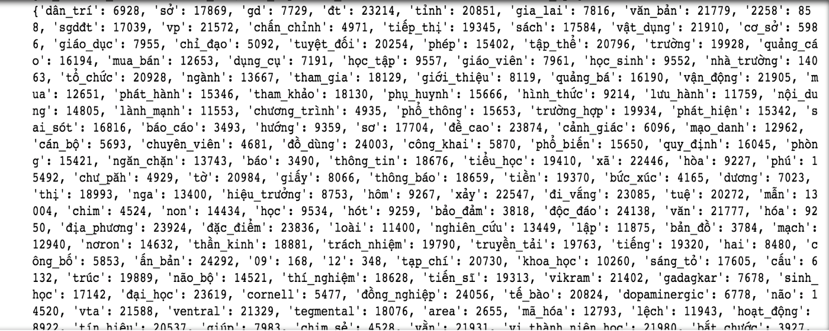
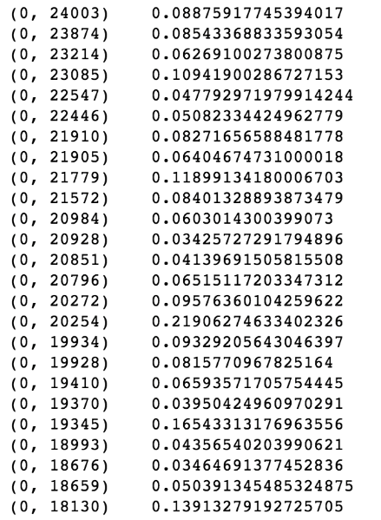
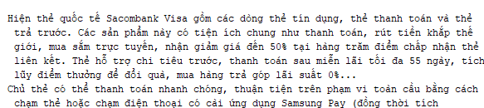
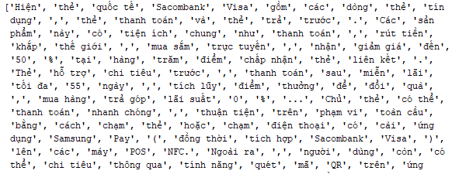
DEMO :: Steps
Tokenize
Dictionary
Data Input (tfidf-Vector)

Slide 29
DEMO :: Exercise
Exercise: Calculate vector representation of text with small dataset.
Data: 2 articles from Dan tri site.
Request:
Use the word separator module.
Build a dictionary from 2 documents
Use a list of stopwords filter stopwords.
Convert 2 documents into 2 vector tfidf

Slide 30
Summary (Take-home messages)
The data in a field before entering the machine learning system must be collected and represented in a structured form with some characteristics: completeness, integrity, homogeneity, well-defined structure.
The data collected for the learning process is a small set, but it should reflect all aspects of the problem to be solved.
Raw data, after collection and preprocessing, must retain the full range of semantic features – features that affect problem solving.
Data science is a broad field, in addition to using applied tools, mastering the basics is important.

